Slide 1

Battle of the Neighborhoods
CC BY-NC
Vegetarian/Vegan Cuisine in Manhattan, NYC
Part of IBM Data Science Professional Capstone

Slide 2

New York City & Vegan/Vegetarian Food Overview
New York City has over 8 million residents and received over 65 million visitors in 2018.
Over 24,000 restaurants are in New York City, of many different varieties and cuisines, with approximately 10,000 located in Manhattan alone.
Over 9 million Americans adhere to a plant based diet.
In 2018, the global vegan food market was estimated to be over $12 billion, which shows that there is a definite market for plant based foods.

Slide 3
Project Target Audience & Goals
NYC Tourists
As there are a large number of individuals who adhere to a plant-based diet, and there are a large number of visitors to New York City each year, a target for our project would be vegan/vegetarian tourists coming to visit NYC and looking for a place to eat.
Business Owners
With many places to eat in New York City, this project may appeal to a business owner looking to start a restaurant that will cater to vegetarians/vegans.
Goals
To show the best places where a tourist should visit to find plant-based menu items.
To see if there is a need for a new restaurant that could be located in an optimal location in order to appeal to vegetarians/vegans.

Slide 4

Data Collection and Cleaning
The New York City geographical data for our project was found from publicly available information at https://cocl.us/new_york_dataset.
Foursquare’s API was also used to provide detailed location data.
Process:
Data was gathered, cleaned and placed in dataframes.
Specific areas of focus are the plant-based food offerings in Manhattan, NYC.
This Photo by Unknown Author is licensed under CC BY-SA

Slide 5
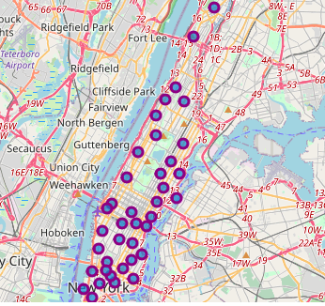
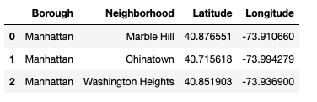
Manhattan Neighborhood Data
Using Folium and our dataframes, a map of Manhattan was created, showing the borough’s neighborhoods.
Manhattan’s geographical coordinates are 40.7896239, -73.9598939.

Slide 6
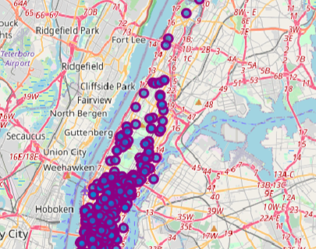
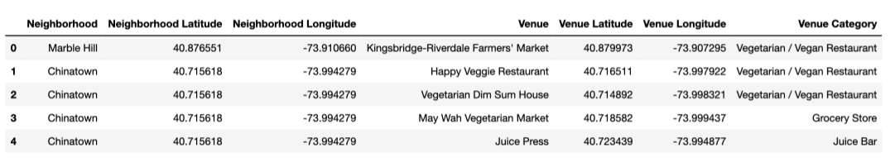
Foursquare API
Using the Foursquare API, I obtained the top 100 venues in Manhattan within a radius of 500 meters, filtered by venues serving vegetarian/vegan cuisine.
A new dataframe was created, along with an updated map of Manhattan, showing vegetarian/vegan offerings in the borough’s neighborhoods.

Slide 7
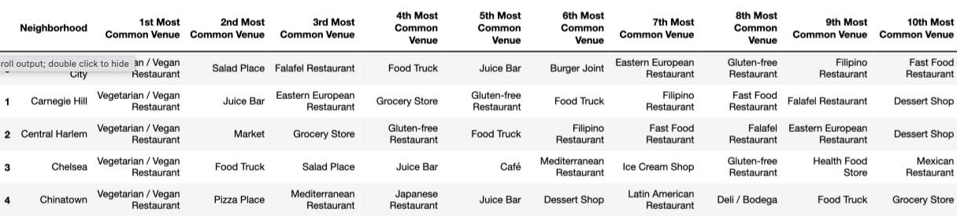
Analyze Each Neighborhood
Onehot encoding was used to break down the information to show each neighborhood’s vegan/vegetarian offerings by venue type (café, Asian Restaurant, etc.).
Rows were grouped by neighborhood with mean of the frequency of occurrence for each venue category.
Top venue frequency serving plant-based offerings was Vegetarian/Vegan Restaurants.
Dataframe was sorted and printed to show top 10 most common venues serving plant-based menu offerings by neighborhood.

Slide 8
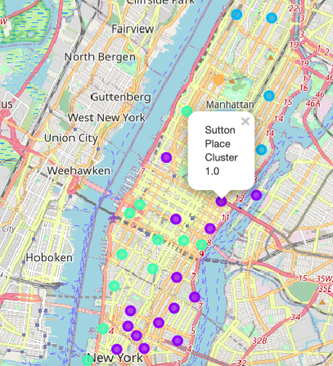
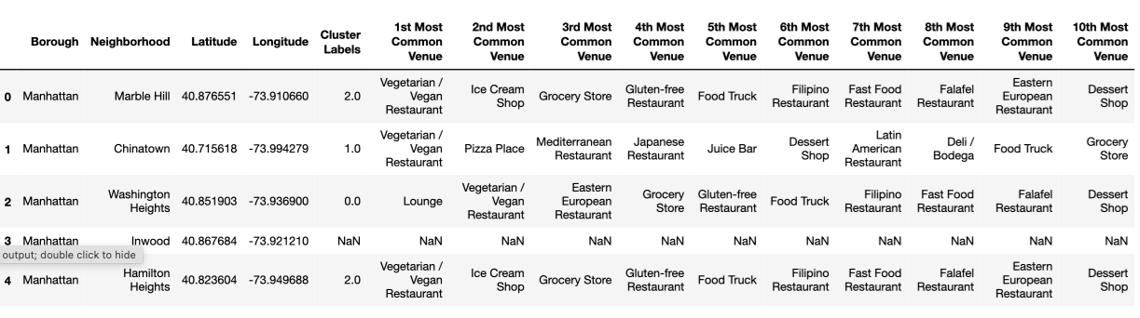
K-Means Clustering Analysis
K-Means Clustering was used to divide Manhattan neighborhoods into 5 clusters.
New dataframe was created to show top 10 venues in each cluster and new map was created to visualize clusters.

Slide 9
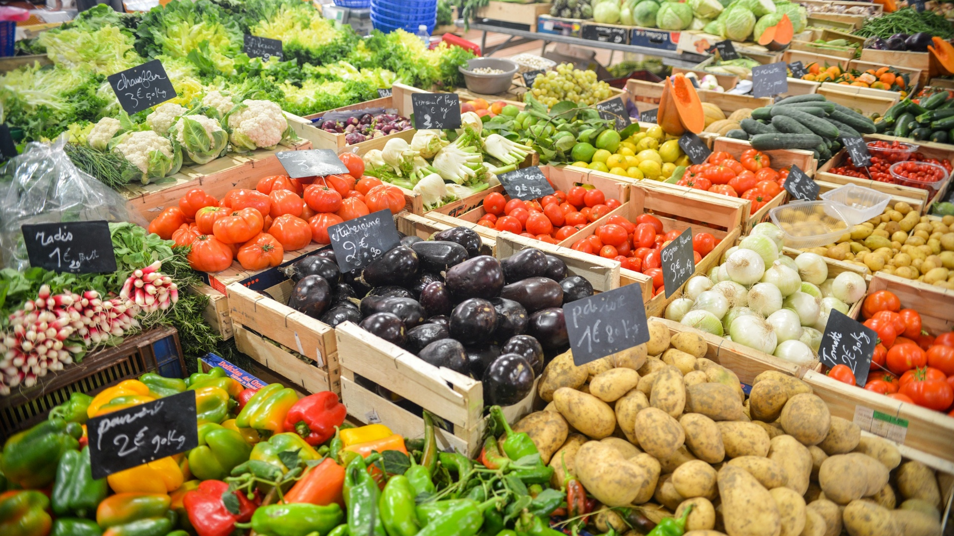
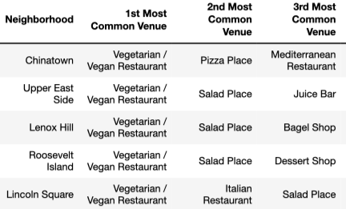
Analyze Results
Each of the 5 clusters were analyzed according to the top 10 venues.
Vegan/Vegetarian restaurants were the most frequent venues to serve plant-based food. Salad Places and Juice Bars also had a high number of plant-based food offerings, particularly in clusters 2-5.

Slide 10
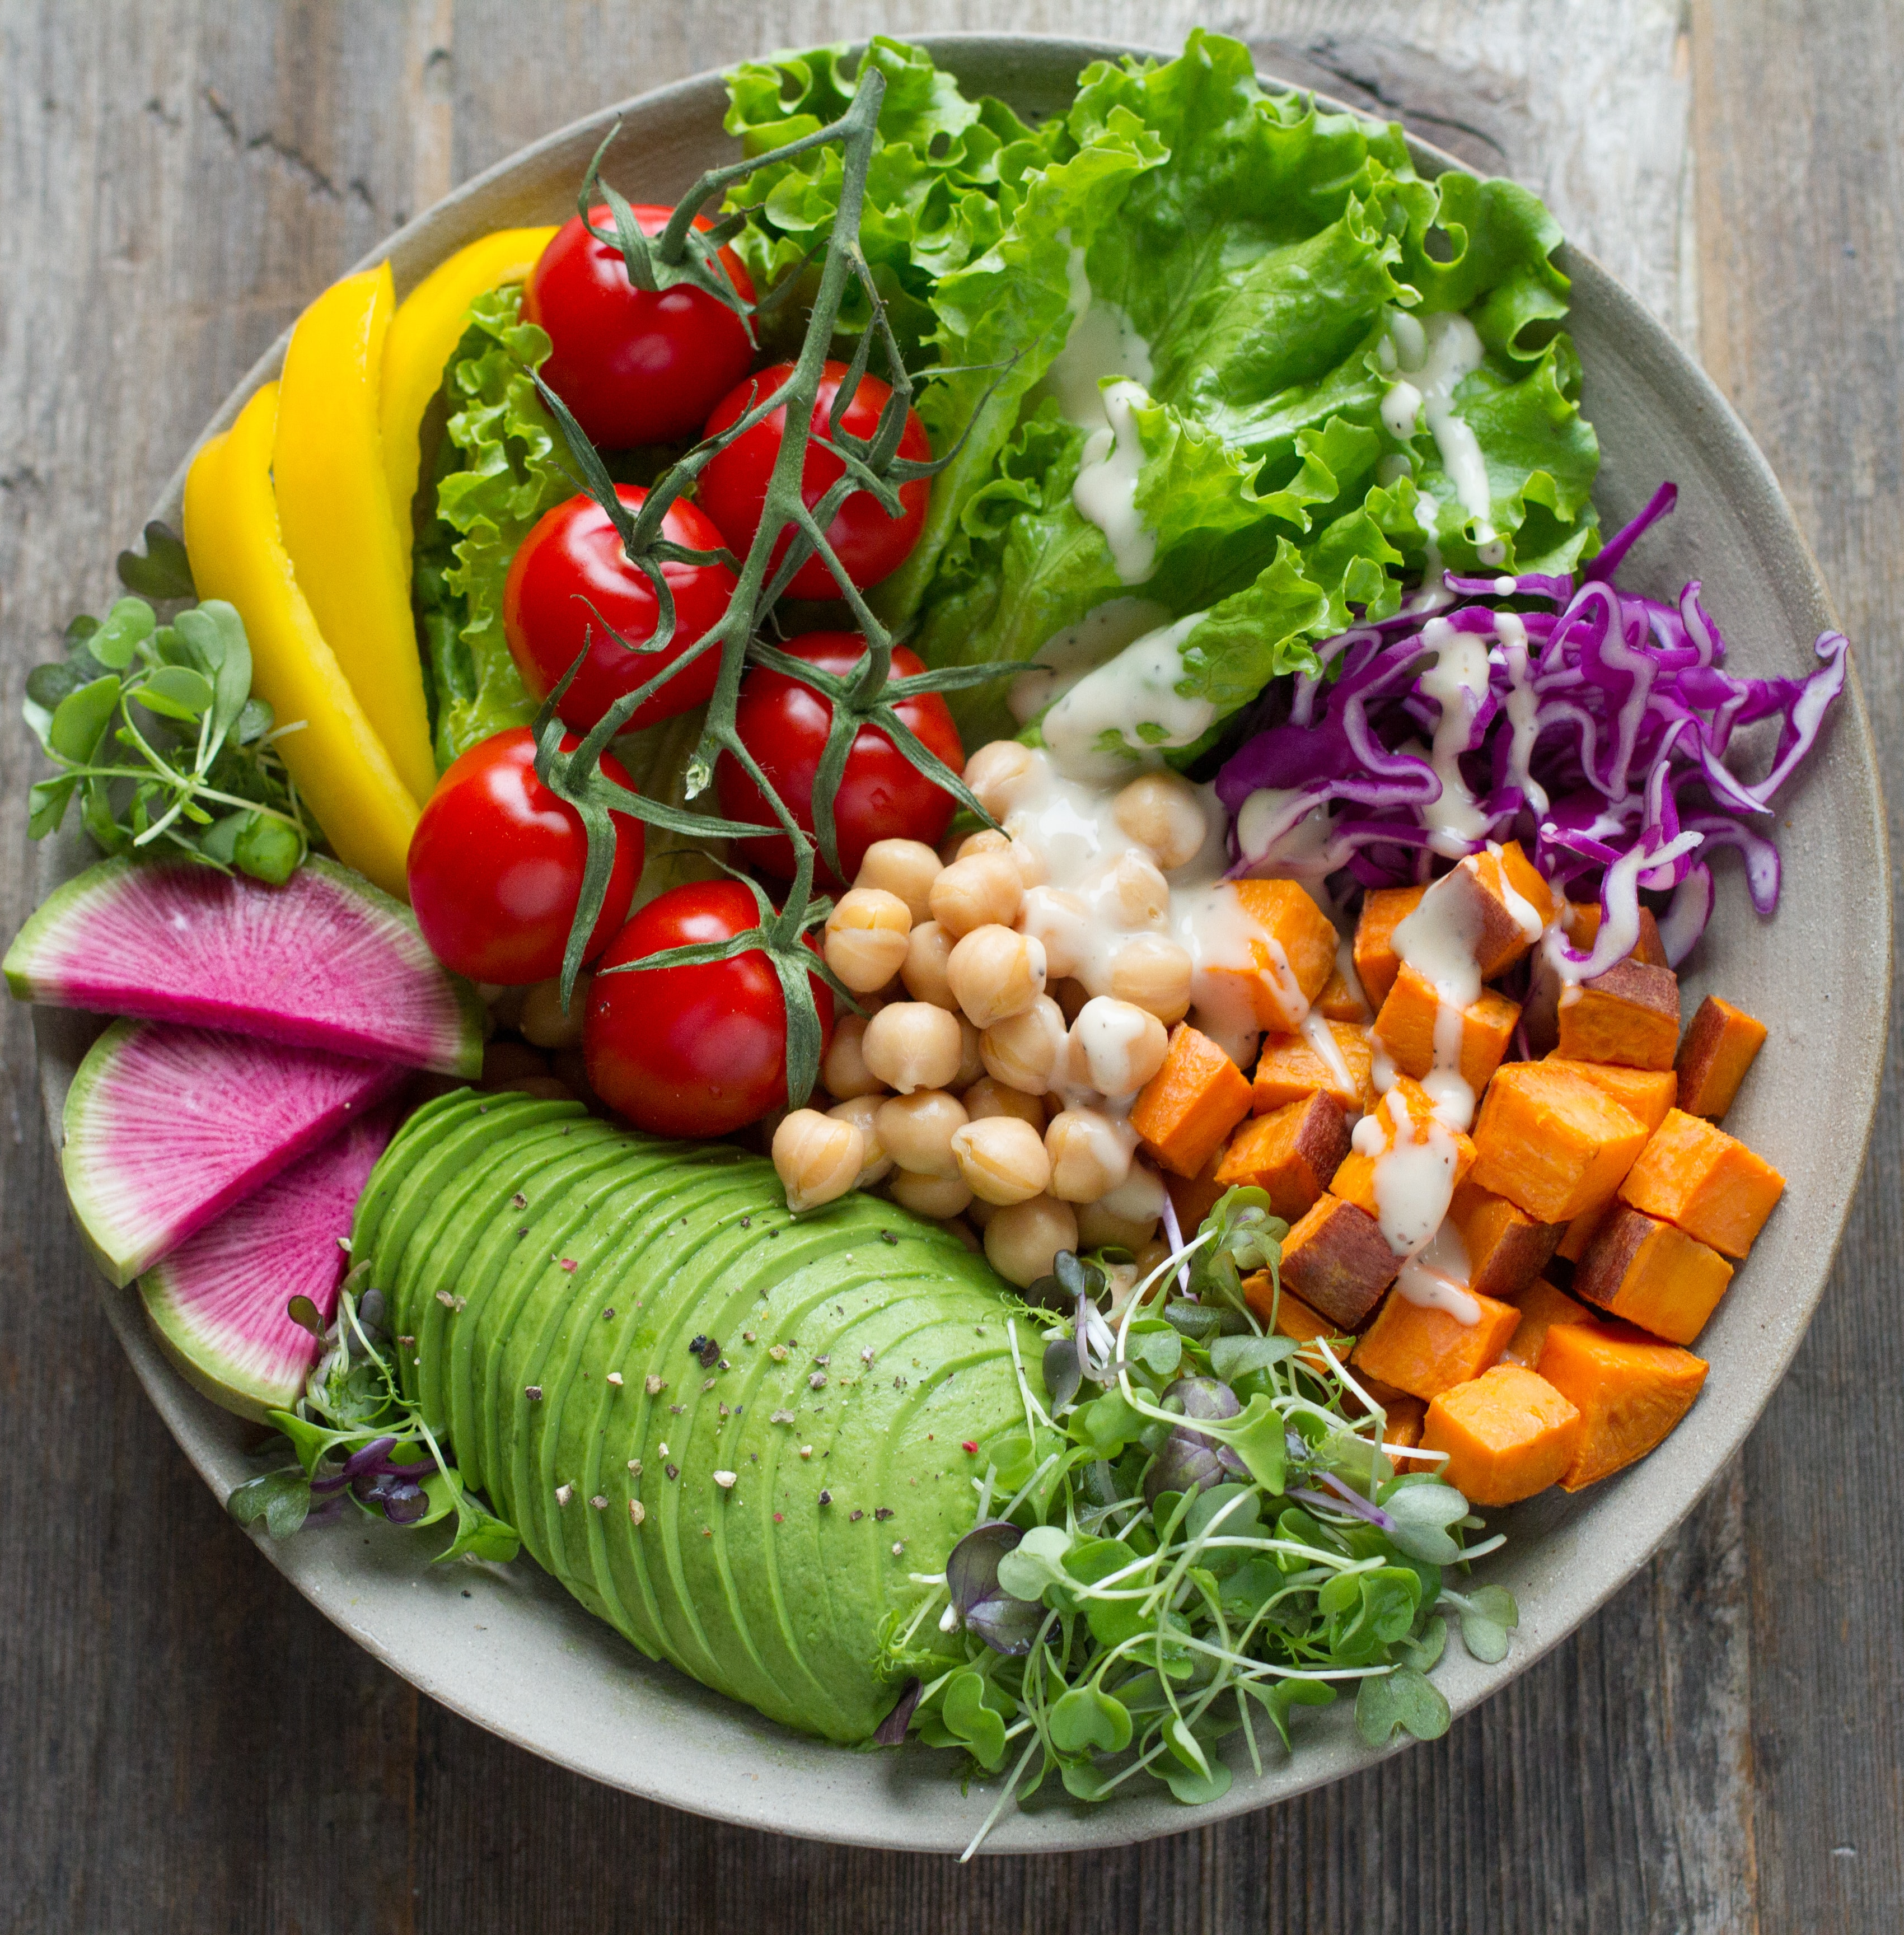
Conclusion
Vegan/Vegetarian restaurants are the most frequent venues serving plant-based meal options. Juice Bars and Salad Places also carry these items more than other types of cuisines.
Several neighborhoods (Chelsea, SoHo, Lower East Side) contain a wide variety of cuisines serving plant-based foods, which tourists may want to visit.
As there are already many standalone Vegan/Vegetarian restaurants in Manhattan, a business owner might wish to open a restaurant of a different venue/cuisine that still has large number of plant-based menu items in order to cater to a wider audience.
This Photo by Unknown

